Slide 1
UGE1577: Intellectual Property Rights
Unit 1 - Introduction

Slide 2
Unit-1 Syllabus
Introduction to IPRs,
Basic concepts and need for Intellectual Property
Patents, Copyrights, Geographical Indications,
Nature of Intellectual Property
Industrial Property
Technological Research,
Inventions and Innovations
Important examples of IPR.

Slide 3
1.1 Introduction to IPRs
Technological advances since the advent of science continue to shape human life
Property has always been considered as essential for the proper development of personality.
But it is not a static concept. It has evolved over time in a dynamic and flexible concept
Property is not a relationship between people and things rather than it is a relationship between people with regard to things.
The concept of property is changing today in small, yet dramatic ways.
Now ideas, including writings, compositions and art are considered as property.

Slide 4
1.1 Introduction to IPRs
There are three distinct types of property that individuals and companies can own Property:
Real Property : Real property refers to land or real estate.
Personal Property : Personal property refers to specific items and things that can be identified, such as jewelry , cars and stock.
Intellectual Property : Intellectual property refers to the fruits or products of human creativity, including literature, advertising, slogans, songs or new inventions.
Thus, property that is the result of thought, namely, intellectual activity is called intellectual property.

Slide 5
1.1 Introduction to IPRs
International protection of intellectual property acts as a sour to human creativity and international trade.
The recognition of the creator and inventor, the protection of their rights and commercialization of their creative products, contribute to sustainable economic growth.
The World Intellectual Property Organization (WIPO) is one of the specialized agencies of the United Nations (UN) system of organizations.
The “Convention Establishing the World Intellectual Property Organization” was signed at Stockholm in 1967 and entered into force in 1970
Trade Related Aspects of Intellectual Property Rights (TRIPS)
The origin of WIPO go back to 1883 and 1886

Slide 6
1.2 Basic Concepts and Need for Intellectual Property
Intellectual property rights (IPR) refers to the legal rights given to the inventor or creator to protect his invention or creation for a certain period
These legal rights confer an exclusive right to the inventor/creator or his assignee to fully utilize his invention/creation for a given period. It is very well settled that IP play a vital role in the modern economy.

Slide 7
1.2 Basic Concepts and Need for Intellectual Property
IP protection includes:
Patents
Industrial designs relates to features of any shape, configuration, surface pattern, composition of lines and colors applied to an article whether 2-D, e.g., textile, or 3-D, e.g., toothbrush
Trademarks relate to any mark, name, or logo under which trade is conducted for any product or service and by which the manufacturer or the service provider is identified.
Trademarks can be bought, sold, and licensed
Copyright relates to expression of ideas in material form and includes literary, musical, dramatic, artistic, cinematography work, audio tapes, and computer software.
Geographical indications are indications, which identify as good as originating in the territory of a country or a region or locality in that territory

Slide 8
1.2.1 Some Formal Definitions
The Paris Convention for the Protection of Industrial Property defines its subject matter in general terms:
The protection of industrial property has as its object patents, unity models, industrial designs, trademarks, service marks, trade names, indications of source or appellations of origin, and the repression of unfair competition. Industrial property shall be understood in the broadest sense and shall apply not only to industry and commerce proper, but likewise to agricultural and extractive industries and to all manufactured or natural products, for example, wines, grain, tobacco leaf, fruit, cattle , minerals, mineral waters, beer, flowers and flour

Slide 9
1.2.2 Objectives of Intellectual Property Rights
It helps in protecting the ownership and originality of the individuals creation.
It provides recognition to the concerned person or authority.
It allows owners of intellectual property to have financial benefits from the property they have created.
They are provided financial incentive for the creation of and also to incur the cost of investment in intellectual property.
Such rights motivate individuals’ creativity and thus also contributes to economic growth.
It can also offer some economic aid to the holder of the right, through the monopoly of their creations.
It improves the financial status of the individual as well as of the economy of the country

Slide 10
1.2.3 Types of Intellectual Property
Copyright protects original works of authorship, including literary, music, dramatic, artistic and other works. Copyright exists from the moment of creation of a work. It gives a copyright holder the exclusive right to control reproduction or adaptation of such work for a certain period.
A patent may be granted for a new, useful and non-obvious invention and gives the patent holder a right to prevent others from practicing the invention without a license from the inventor for a certain period.

Slide 11
1.2.3 Types of Intellectual Property
A trademark is a word, name, symbol, or device used to indicate the origin, quality and ownership of a product or service. A trademark is a distinctive sign which is used to distinguish the products or services of different businesses.
A trade secret consists of any valuable commercial information that, if known by a competitor, would provide some benefit or advantage to the competitor.
An industrial design right protects the form of appearance, style or design of an industrial object (spare parts, furniture or textiles)

Slide 12
1.2.4 Significance of Intellectual Property Rights
Intellectual property rights provides incentives as well as recognition to the concerned persons / authorities / nations / institutions / or organizations.
Intellectual property rights encourages innovations and ensures a better quality of life. Industrial designs are what make a product attractive and appealing ; hence, they add to the commercial value of a product and increase its marketability.
Just like the elements of a good product or service, the elements of a good advertisement are likely to be imitated or copied by others. So, it is hardly surprising that one or more types of IP rights come into play in creating content for an advertisement, or while deploying an advertising campaign

Slide 13
1.3 Patents
A patent is an exclusive right granted for an invention, which is a product or a process that provides, in general, a new way of doing something, or offers a new technical solution to a problem
To get a patent, technical information about the invention must be disclosed to the public in a patent application
Once a patent expires, the protection ends, and an invention enters the public domain; that is, anyone can commercially exploit the invention without infringing the patent.
A patent is awarded for an invention, which satisfies the criteria of global novelty, non-obviousness, and industrial or commercial application. Patents can be granted for products and processes
No product patents were granted for drugs and food items

Slide 14
1.3 Patents
Is a patent valid in every country :
Patents are territorial rights. In general, the exclusive rights are only applicable in the country or region in which a patent has been filed and granted, in accordance with the law of that country or region
The protection is granted for a limited period, generally 20 years from the filing date of the application

Slide 15
1.3.1 The Kind of Protection a Patent Offer
Rights provided by Patent :
A patent owner has the right to decide who may or may not use the patented invention for the period in which the invention is protected.
In other words, patent protection means that the invention cannot be commercially made, used, distributed, imported, or sold by others without the patent owner's consent.
Kinds of inventions can be protected through Patent :
Patents may be granted for inventions in any field of technology, from an everyday kitchen utensil to a nanotechnology chip. For example, a laptop computer can involve hundreds of inventions, working together

Slide 16
1.3.2 Manner in which Patent Rights Enforced
Patent rights are usually enforced in a court on the initiative of the right owner.
In most systems a court of law has the authority to stop patent infringement.
However, the main responsibility for monitoring, identifying, and taking action against infringers of a patent lies with the patent owner
Licensing a patent : Licensing a patent simply means that the patent owner grants permission to another individual/organization to make, use, sell etc. his/her patented invention.
This takes place according to agreed terms and conditions

Slide 17
1.3.4 Conditions Must be Met to Obtain Patent Protection
The invention must show an element of novelty ; that is, some new characteristic which is not known in the body of existing knowledge in its technical field. This body of existing knowledge is called “prior art”.
The invention must involve an “inventive step” or “non-obvious”, which means that it could not be obviously deduced by a person having ordinary skill in the relevant technical field.
The invention must be capable of industrial application, meaning that it must be capable of being used for an industrial or business purpose beyond a mere theoretical phenomenon, or be useful.

Slide 18
1.3.4 Conditions Must be Met to Obtain Patent Protection
Its subject matter must be accepted as “patentable” under law.
In many countries, scientific theories, aesthetic creations, mathematical methods, plant or animal varieties, discoveries of natural substances, commercial methods, methods for medical treatment (as opposed to medical products) or computer programs are generally not patentable
The invention must be disclosed in an application in a manner sufficiently clear and complete to enable it to be replicated by a person with an ordinary level of skill in the relevant technical field

Slide 19
1.3.5 Reasons for Patenting Inventions
Exclusive rights
Return on investments
Opportunity to license or sell the invention
Increase in negotiating power
Positive image for your enterprise

Slide 20
1.3.7 The Following Would Not Qualify as Patents
An invention, which claims anything obvious or contrary to the well- established natural law.
An invention, the primary or intended use of which would be contrary to law or morality or injurious to public health
A discovery, scientific theory, or mathematical method.
A mere discovery of any new property or new use for a known substance or of the mere use of a known process, machine.
A mere arrangement or re-arrangement or duplication of a known device each functioning independently of one another in its own way.
A method of agriculture or horticulture.
An invention relating to atomic energy.
An invention, which is in effect, is traditional knowledge.

Slide 21
1.3.8 Types of Patents
Utility Patent
A Manufactured Article : Nail cutter or spanner
A Machine : Washing machine, television, compressor, car or grass cutter
Composition of Matter : Paint, hair, dye, medicine
A Process for Making or Doing Something
Design Patent
A design patent covers a new and original ornamental shape or a surface treatment of a manufactured article
Plant Patent
A plant patent applies to characteristics of a new plant

Slide 22

Working Mechanism – PATENT
Shape - DESIGN
Brand Name - TRADE MARK
Manual - COPY RIGHT

Slide 23
Cost involved
Patent Application
Filing charges Rs. 4,000
Request for early publication Rs.10,000 (otherwise wait for 18 months)
Request for examination Rs.10,000
Total Rs.24,000 (self drafting/self filing)
Drafting charges Rs.25,000
Filing charges Rs.10,000
Total through Attorneys Rs.59,000
To keep the patent in force, it has to be renewed annually.
The Renewal charge increases with the age of the patent.
The idea is that as time progresses, you would have made some revenue out of the invention.

Slide 24

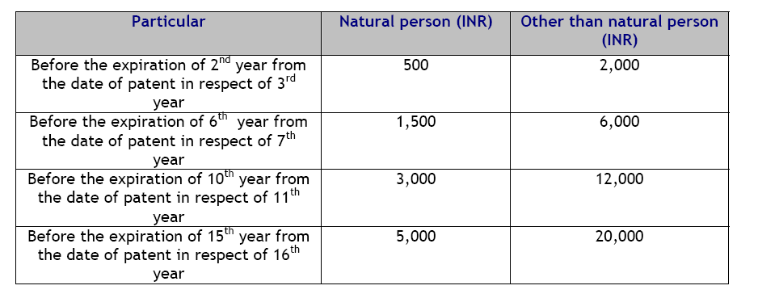
2nd to 6th year 5 x Rs.2,000 Rs.10,000
7th to 10th year 4 x Rs.6,000 Rs.24,000
11th to 14th year 4 x Rs.12,000 Rs.48,000
15th and 16th year 2 x Rs.20,000 Rs.40,000
Total maintenance cost for 16 years Rs,1,22,000

Slide 25
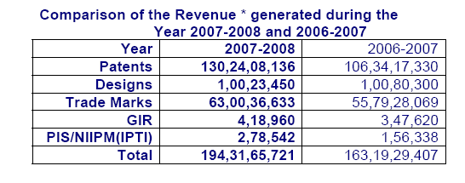
Cost to us = Income to government
Patent Application

Slide 26
The important question
Patent Application
Total maintenance cost for 16 years Rs,1,22,000
Add filing charges through attorneys Rs. 59,000
Average cost of a patent Rs.1,81,000
Can you generate
at least this much revenue from the invention
over a period of 16 years?
Only then, it is worth patenting!

Slide 27
1.4 Copyrights
It is a right that is provided to the owner of a literary or artistic work. It is an exclusive right to control the publication, distribution and adaptation of creative works.
Copyright laws deal with the intellectual property of creative works like articles, books, music, software, painting, etc.
The right lies with the owner cum copyright holder for a certain period of time. As time lapses, the work can be republished or reproduced by others.
Usually, the time span of a copyright extends through the entire life of the owner and lasts up to a period of about 50 to100 years after death.
In case of anonymous works, the right lasts for 95 years after publication or 120 years after the creation

Slide 28
1.4.1 What can be Protected using Copyright ?
Literary works such as novels, poems, plays, reference works, newspaper articles ;
Computer programs, databases ;
Films, musical compositions, and choreography ;
Artistic works such as paintings, drawings, photographs, and sculpture ;
Architecture ;
Advertisements, maps, and technical drawings.
Copyright protection extends only to expressions, and not to ideas, procedures, methods of operation or mathematical concepts as such

Slide 29
1.4.2 Rights Provided under Copyright
Its reproduction in various forms, such as printed publication or sound recording ;
Its public performance, such as in a play or musical work
Its recording, for example, in the form of compact discs or DVDs ;
Its broadcasting, by radio, cable or satellite ;
Its translation into other languages ;
Its adaptation, such as a novel into a film screenplay

Slide 30
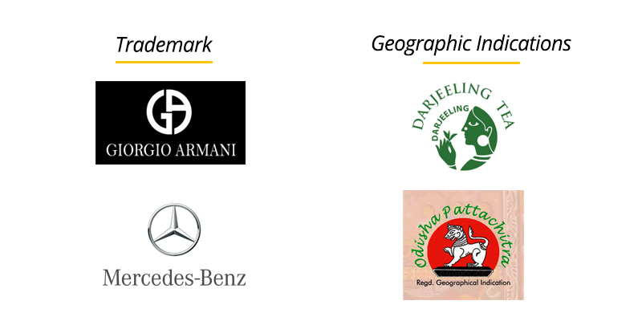
1.5 Geographical Indications

Slide 31
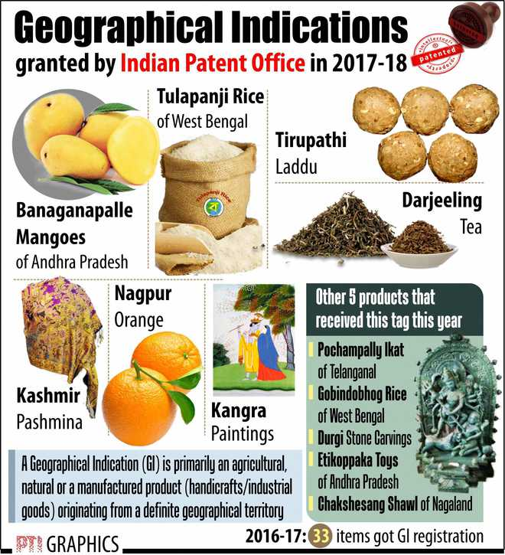

Slide 32
1.5 Geographical Indications
A geographical indication is a sign used on goods that have a specific geographical origin and possess qualities or a reputation that are due to that place of origin.
Most commonly, a geographical indication consists of the name of the place of origin of the goods.
Agricultural products typically have qualities that derive from their place of production and are influenced by specific local factors, such as climate and soil.
An appellation of origin is a special kind of geographical indication, used on products that have a specific quality that is exclusively or essentially due to the geographical environment in which the products are produced. The concept of geographical indication encompasses appellations of origin

Slide 33
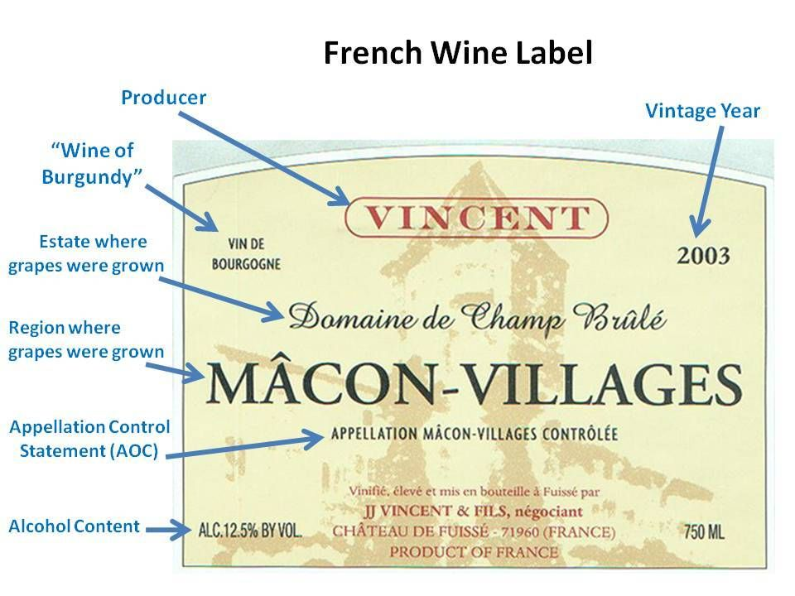

Slide 34
1.5.1 Need of Geographical Indications
Geographical indications are understood by consumers to denote the origin and the quality of products.
Many of them have acquired valuable reputations which, if not adequately protected, may be misrepresented by dishonest commercial operators.
False use of geographical indications by unauthorized parties is detrimental to consumers and legitimate producers.

Slide 35
1.9 Nature of Intellectual Property
Intellectual properties have their own peculiar features. These features of intellectual properties may serve to identify intellectual properties from other types of properties. Thus, we will discuss them in brief.
1. Territorial
Any intellectual property issued should be resolved by national laws. Why is it an issue? Because intellectual property rights have one characteristic which other national rights do not have. In ownership of intellectual property of immovable properties, issues of cross borders are not probable.

Slide 36
1.9 Nature of Intellectual Property
But in intellectual properties, it is common. A film made in Hollywood can be seen in other countries. The market is not only the local one but also international. If a design in China is imitated by another person in France which law would be applicable?
2. Giving an exclusive right to the owner
It means others, who are not owners, are prohibited from using the right. Most intellectual property rights cannot be implemented in practice as soon as the owner got exclusive rights. Most of them need to be tested by some public laws. The creator or author of an intellectual property enjoys rights inherent in his work to the exclusion of anybody else.

Slide 37
1.9 Nature of Intellectual Property
3. Assignable
Since they are rights, they can obviously be assigned (licensed). It is possible to put a dichotomy between intellectual property rights and the material object in which the work is embodied. Intellectual property can be bought, sold, or licensed or hired or attached..
4. Independence
Different intellectual property rights subsist in the same kind of object. Most intellectual property rights are likely to be embodied in objects.

Slide 38
1.9 Nature of Intellectual Property
5. Subject to Public Policy
They are vulnerable to the deep embodiment of public policy. Intellectual property attempts to preserve and find adequate reconciliation between two competing interests.
On the one hand, the intellectual property rights holders require adequate remuneration and on the other hand, consumers try to consume works without much inconvenience. Is limitation unique for intellectual property?

Slide 39
1.9 Nature of Intellectual Property
6. Divisible (Fragmentation)
Several persons may have legally protected interests evolved from a single original work without affecting the interest of other right holders on that same item. Because of the nature of indivisibility, intellectual property is an inexhaustible resource.
This nature of intellectual property derives from intellectual property’s territorial nature. For example, an inventor who registered his invention in Ethiopia can use the patent himself in Ethiopia and License it in Germany and assign it in France. Also, copyright is made up of different rights. Those rights may be divided into different persons: publishers, adaptors, translators, etc.

Slide 40
1.10 Industrial Property
Industrial property is one of two subsets of intellectual property (the other being copyright)
It takes a range of forms, including patents for inventions, industrial designs (aesthetic creations related to the appearance of industrial products), trademarks, service marks, layout-designs of integrated circuits, commercial names and designations, geographical indications and protection against unfair competition.
The object of industrial property consists of signs conveying information, in particular to consumers, regarding products and services offered on the market.

Slide 41
1.11 Technological Research
Technological research proposes stimulating challenges starting from the new scenarios arising since 20th century the environmental imperative imposes new responsibilities,
the industrial production, requires the rethinking of the concept of "material culture" as well as new information technologies lead to new models of theoretical and conceptual elaboration.
We live a new condition where history fades into actuality, space turns into images and individuals from being actors become spectators.
The industrial design moves from tackling "traditional culture" of the project to the "culture of innovation" for which the "know-how", which allows the transition from theory to practice, is replaced by the "can-do“
that is the design of a technological solution allowing to model artifacts in a new way and, therefore, introducing a different interaction between users and the context

Slide 42
1.12 Inventions and Innovations
“Invention” can be defined as the creation of a product or introduction of a process for the first time.
“Innovation,” on the other hand, occurs if someone improves on or makes a significant contribution to an existing product, process or service.
Development of Microprocessor – Invention
Products with Microprocessor - Innovation

Slide 43
Important Examples of IPR Disputes
Amazon's 1-Click Patent
Amazon was granted a patent for 1-click technology on September 28, 1999. Also known as one-click buying, the technology allows customers to make an online purchase in a single click.
There have been several patent disputes surrounding 1-click technology, including a patent infringement lawsuit filed against Barnes & Noble in 1999—only a month after Amazon's patent was issued.
The lawsuit was settled in 2002; however, the terms were not disclosed.

Slide 44
Important Examples of IPR Disputes
Google Trademark Keywords
Google is accused of selling the trademarked name "Rescuecom" as a keyword to Rescuecom's competitors.
The keywords are used to deliver Google's sponsored search results, therefore allowing competitors to appear on the results page when a user searches for "Rescuecom."
The lawsuit was originally filed in 2006 and dismissed by the lower courts.

Slide 45
Trade Secrets: The Coca-Cola Case:
Facts
Coca-Cola with a brand value of $56 billion, according to Forbes Magazine is the fourth most valuable brand in the world and is one of the world’s best-selling carbonated soft drink beverage companies.
It was Asa Griggs Candler, whose innovative ideas and marketing tactics led Coca-Cola to dominate the world’s beverage industries throughout the 20th century and beyond.
This company’s entire industry has built around its exclusive recipe. Thus the company has made great efforts to keep this recipe a secret and until now it is one of the business world’s tightly guarded and best-kept secrets.

Slide 46
Trade Secrets: The Coca-Cola Case:
Facts
The Secret Formula for Coca-Cola is the lifeblood of their business. Instead of using patent legislation to protect its business interests, the Coca-Cola Company opted for trade secret protection and decided to keep its product recycling as a secret to safeguard its advantage over other competitors.
In 1977, Coca-Cola decided to stop its production in India when it was forced to reveal its formula and partner with an Indian company under the Indian Foreign Exchange Regulation Act (FERA). It only returned when, after an absence of 17 long years, India agreed to change its strategy.
The biggest controversy was when some of its employees attempted to sell their secrets to their rival company PepsiCo in 2006. Luckily, PepsiCo immediately notified Coca-Cola of the infringement and later reported this to the FBI as well.

Slide 47
Trade Secrets: The Coca-Cola Case:
ISSUE RAISED:
Whether selling the secret formula of Coca-Cola by some of its employees amounts to infringement of trade secrets?
JUDGEMENT:
The FBI arrested three people connected to the leak of trade secrets after investigation. Ibrahim Dimson, Edmund Duhaney and Joya Williams have been arrested for this incident, and charged.
When looking for classified details, Williams was caught in video surveillance and also caught placing a new Coca-Cola product sample into her purse, which was later checked by the authority as a legitimate prototype product under production.
Joya Williams was sentenced to eight years in prison while Ibrahim Dimson was sentenced to five years in prison and the third defendant, Edmund Duhaney was sentenced to two years in prison for planning to steal the Coca-Cola Co. trade secrets and to sell them to rival PepsiCo Inc.

